Slide 1
Weekly letter w. 42
HR Core Information flow

Slide 2
Definition of Green / Yellow / Red Track
Green Track: Ready at MainGoLive
Yellow Track: Ready after MainGoLive (mitigation will be set in place temporarily)
Red Track: Out of scope completely (mitigation will be set in place permanently)

Slide 3
General prioritization of activities
Bug fix - go-live critical errors Green Track (or critical publishing side)
Build Green Track
Bug fix - non-go-live critical Green Track
Build Yellow Track
Bug-fix after “MainGoLive” bugs (involve redesign and rework)
Build consumer prio 2
Build consumer prio 3
Red Track not to be developed/tested

Slide 4
Status w. 42
Solution Architects
Activities scheduled
Integration Request | Start date | Target date
Peakon | 4/8 | 1/9
Synergi | 11/8 | 29/8
Responsible SA | System
Per Anders Jørgensen | ProMark NO, HRM, DK Middleman, Mepco, Coolpro
Patrik Vesth | BR, C7, Billy, Benify
Jan Nielsen Damlund | Unit4, Carsmart
Oscar Sjödén | Unit4, Billy
Mats Sjöström | TEM, Totara, Peakon, Synergi
Simon Boman | SuccessFactor
Tobias Stein | ClearSkye
Define | Start date | Target date
Totara |  | 8/7
Peakon | 2/9 | 20/10
Synergi | 1/9 | 12/9
Design | Start date | Target date
Ramp Totara | 4/8 | 27/11
Adapter Peakon TBD | 16/9 | 7/11
Ramp Peakon | 16/9 | 7/11
Ramp Carsmart | 15/9 | 27/10
Ramp Synergi | 13/10 | 24/10

Slide 5
Status w. 42
NCIP team
Green Track
Yellow Track
Red Track
Activities scheduled
Design | Start date | Target date
Design Totara Ramp | 4/8 | 27/11
Design Carsmart Ramp | 14/10 | 27/10
Design Peakon Ramp | 21/10 | 7/11
Ramp Synergi | 13/10 | 24/10
Development | Start date | Target date
Prio 2 consumers ↓
TEM-Employee2409-Sub | 24/9 | 21/10
TEM-Employee2409WithBankAccount-Sub | 24/9 | 21/10
TEM-Identity2409-Sub | 24/9 | 21/10
Totara-Employee2409CurrentlyEffective-Sub | 25/9 | 6/11
Carsmart-Employee2409CE-Sub | 28/10 | 18/11
Carsmart-EmploymentTerminated-Sub | 28/10 | 18/11
Billy-Employee2409CurrentlyEffective-Sub | 27/10 | 17/11
Billy-Identity2409-Sub | 18/11 | 1/12
Coolpro-Employee2409CurrentlyEffective | 20/11 | 10/11
Development | Start date | Target date
SuccessFactors-EmployeeCountryEmployeeNumberUpdated-Sub | 20/10 | 28/10

Slide 6
Status w. 42
Adapter team
Green Track
Yellow Track
Red Track
Activities scheduled
Design | Start date | Target date
Design Adapter Peakon (TBD if adapter is needed) | TBD
Design DK Middleman UC Yellow Track: GCH integration file - INM Change of Compensation WCW Hire (new foreign manager) Change of formal manager (foreign) GCH integration file – IDC FrontAvenue integration | 6/10 | 17/10
Development | Start date | Target date
Peakon Adapter? | TBD
DK Middleman UC: GCH integration file – INM | 20/10 | 10/11
DK Middleman UC: Change of Compensation WCW | 20/10 | 10/11
DK Middleman UC: Hire (new foreign manager) | 20/10 | 10/11
DK Middleman UC: Change of formal manager (foreign) | 20/10 | 10/11
DK Middleman UC: GCH integration file – IDC | 20/10 | 10/11
DK Middleman UC: FrontAvenue integration | 20/10 | 10/11

Slide 7
Status w. 42
SIT test team
Green Track
Yellow Track
Red Track
Activities scheduled
Test | Start date | Target date
Unit4 Adapter: Hire, Termination, Rehire, (Identity), Employee2409WithBankAccount | In progress
DK Middleman Adapter | In progress
Test | Start date | Target date
Prio 2 consumers ↓
Benify: Employee2409CurrentlyEffective | Ready to test | 10/11
Benify: Compensation | Ready to test | 10/11
TEM-Employee2409-Sub | 27/10 | 10/11
TEM-Employee2409WithBankAccount-Sub | 27/10 | 10/11
TEM-Identity2409-Sub | 27/10 | 10/11
C7: Identity2409 | Ready to test | 10/11
C7: Employee2409CurrentlyEffective | Ready to test | 10/11
Ramp DK Middleman: EmployeeCountryEmployeeNumberUpdated-Pub | 20/10 | 28/10
Adapter DK Middleman: EmployeeCountryEmployeeNumberUpdated-Pub | Ready to test | 27/10
SF: EmployeeCountryEmployeeNumberUpdated-Sub | 29/10 | 7/11
Mepco: EmploymentTerminated2409 |  | 23/9
Mepco: Compensation |  | 19/9
Mepco: EmployeeRehired | In progress
Mepco: Identity2409 |  | 19/9

Slide 8
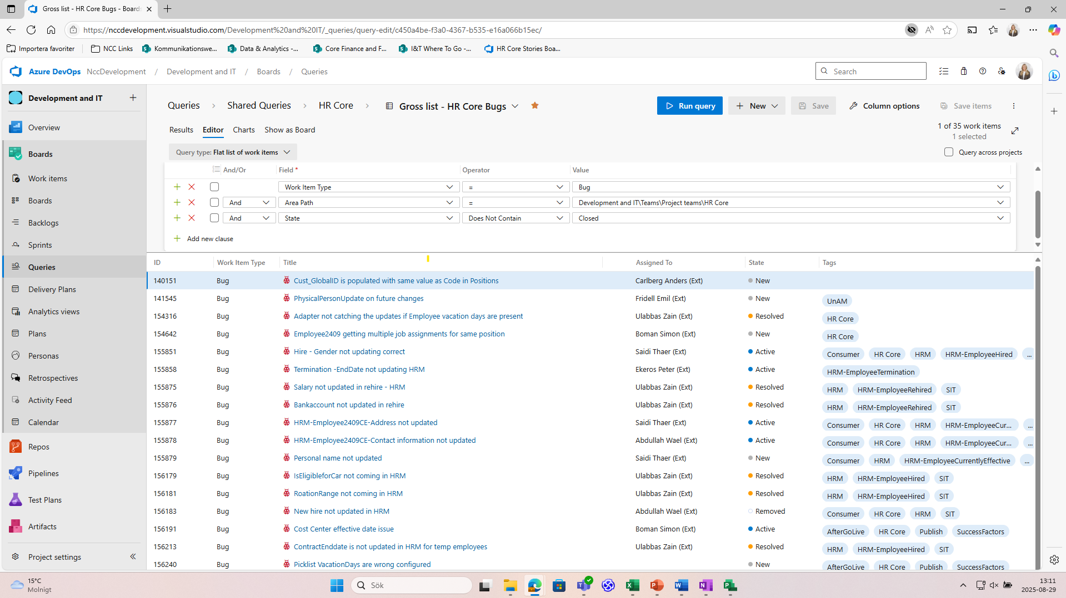

Status w. 42
Gross list of open bugs
https://nccdevelopment.visualstudio.com/Development%20and%20IT/_queries/query/?tempQueryId=dd2ad1b3-5fae-44f3-9c64-1d50ba195419

Slide 9
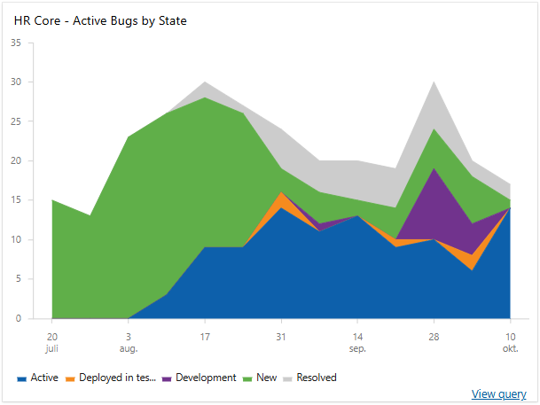
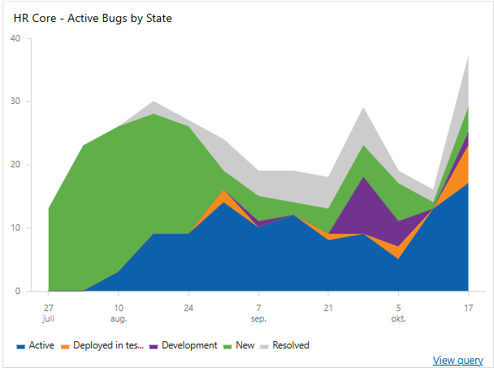
Dashboard view of new and active bugs w. 42
2025-10-10:
Active (incl dep to test, dev, code review): 14
New: 1
Resolved: 2
Closed: 260
2025-10-17:
Active (incl dep to test, dev, code review): 25
New: 4
Resolved: 8
Closed: 272
The chart tracks the bug status, showing Active Bug trends by State. States included in this view is: Active, New & Resolved.
Peak due to opening up ”AfterGoLive” bugs

Slide 10
E2E progress per consumer w. 42
ProMark NO
Test cases
 | Pass | Blocked | Fail | Not Run | N/A
Coverage | 62% | 0% | 23% | 16% | 0%
N/A = test cases not applicable to consumer

Slide 11
E2E progress per consumer w. 42
Unit4
Test cases
 | Pass | Blocked | Fail | Not Run | N/A
Coverage | 91% | 0% | 3% | 6% | <0,5%
N/A = test cases not applicable to consumer

Slide 12
E2E progress per consumer w. 42
HRM
Test cases
 | Pass | Blocked | Fail | Not Run
Coverage | 83% | 0% | 16,5% | 0,5%

Slide 13
E2E progress per consumer w. 42
DK Middleman (ProMark DK and EPOS)
Test cases
Test cases
 | Pass | Blocked | Fail | Not Run
Coverage | 42% | 0% | 11% | 48%
 | Pass | Blocked | Fail | Not Run
Coverage | 56% | 0% | 21% | 22%

Slide 14
E2E progress per consumer w. 42
Mepco
Test cases
 | Pass | Blocked | Fail | Not Run
Coverage | 1,5% | 14% | 12% | 78%

Slide 15
Additional activities?
Additional activities
Activity | Start date | Target date
Missing an activity you are working on in the previous lists? Feel free to add the activity here

